Slide 1
Diabetes Awareness
David Stagner, Melissa Memel, Lance Weston, Rosalind White, Ryan Muir

Slide 2
Disease Overview
Diabetes is a metabolic condition characterized by an increase in blood sugar levels, called hyperglycemia.
Nearly 500 Million people worldwide are affected by this disease.
And, nearly 15% of all health care costs are incurred by individuals with diabetes.
Known to have high correlation to many other conditions...

Slide 3
Objective:
Choose An Appropriate Model
Find Reliable Data
Normalize Data To Best Fit Our Model
Predict
Diabetes
Risk

Slide 4
Objective:
Choose An Appropriate Model
Find Reliable Data
Normalize Data To Best Fit Our Model
Predict
Diabetes
Risk
Early detection is an import step towards keeping people with diabetes healthy

Slide 5
Data Clean Up and Normalization
Data Sources: Kaggle and Vanderbilt University
Renamed Columns to allow for Merging
Used Columns to Calculate BMI ( 703*weight(lbs)/height (in)**2 )
Used Columns to Calculate A1c ( (46.7+Glucose)/28.7 )
Dropped remaining rows containing Null values
Notes:
We only dropped approximately 15 rows of data due to Null values

Slide 6
PostgreSQL
We used SqlAlchemy to connect and create our database.
Having a database will allow for continual additions to the dataset, while protecting its integrity.
We also now have a direct connection to our data visualization software, Tableau...

Slide 7
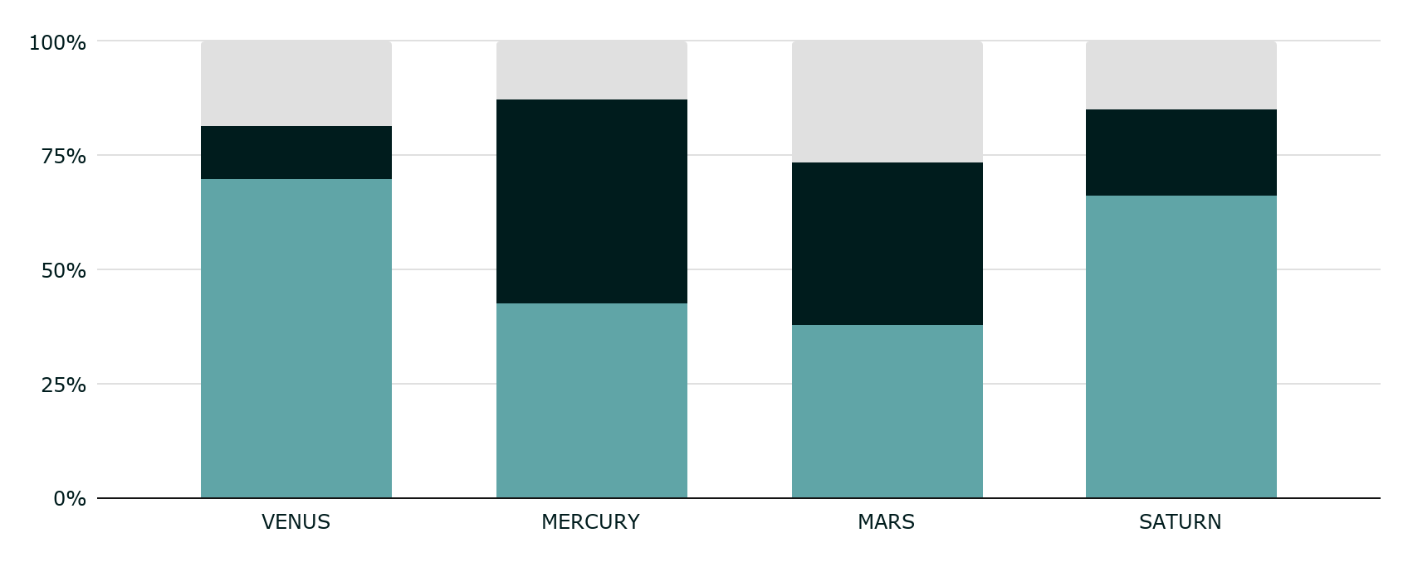
Tableau & Data Analysis
Tableau was our chosen software to visualize our data before choosing a model.
By visualizing our data we can start to see the data trends.

Slide 8
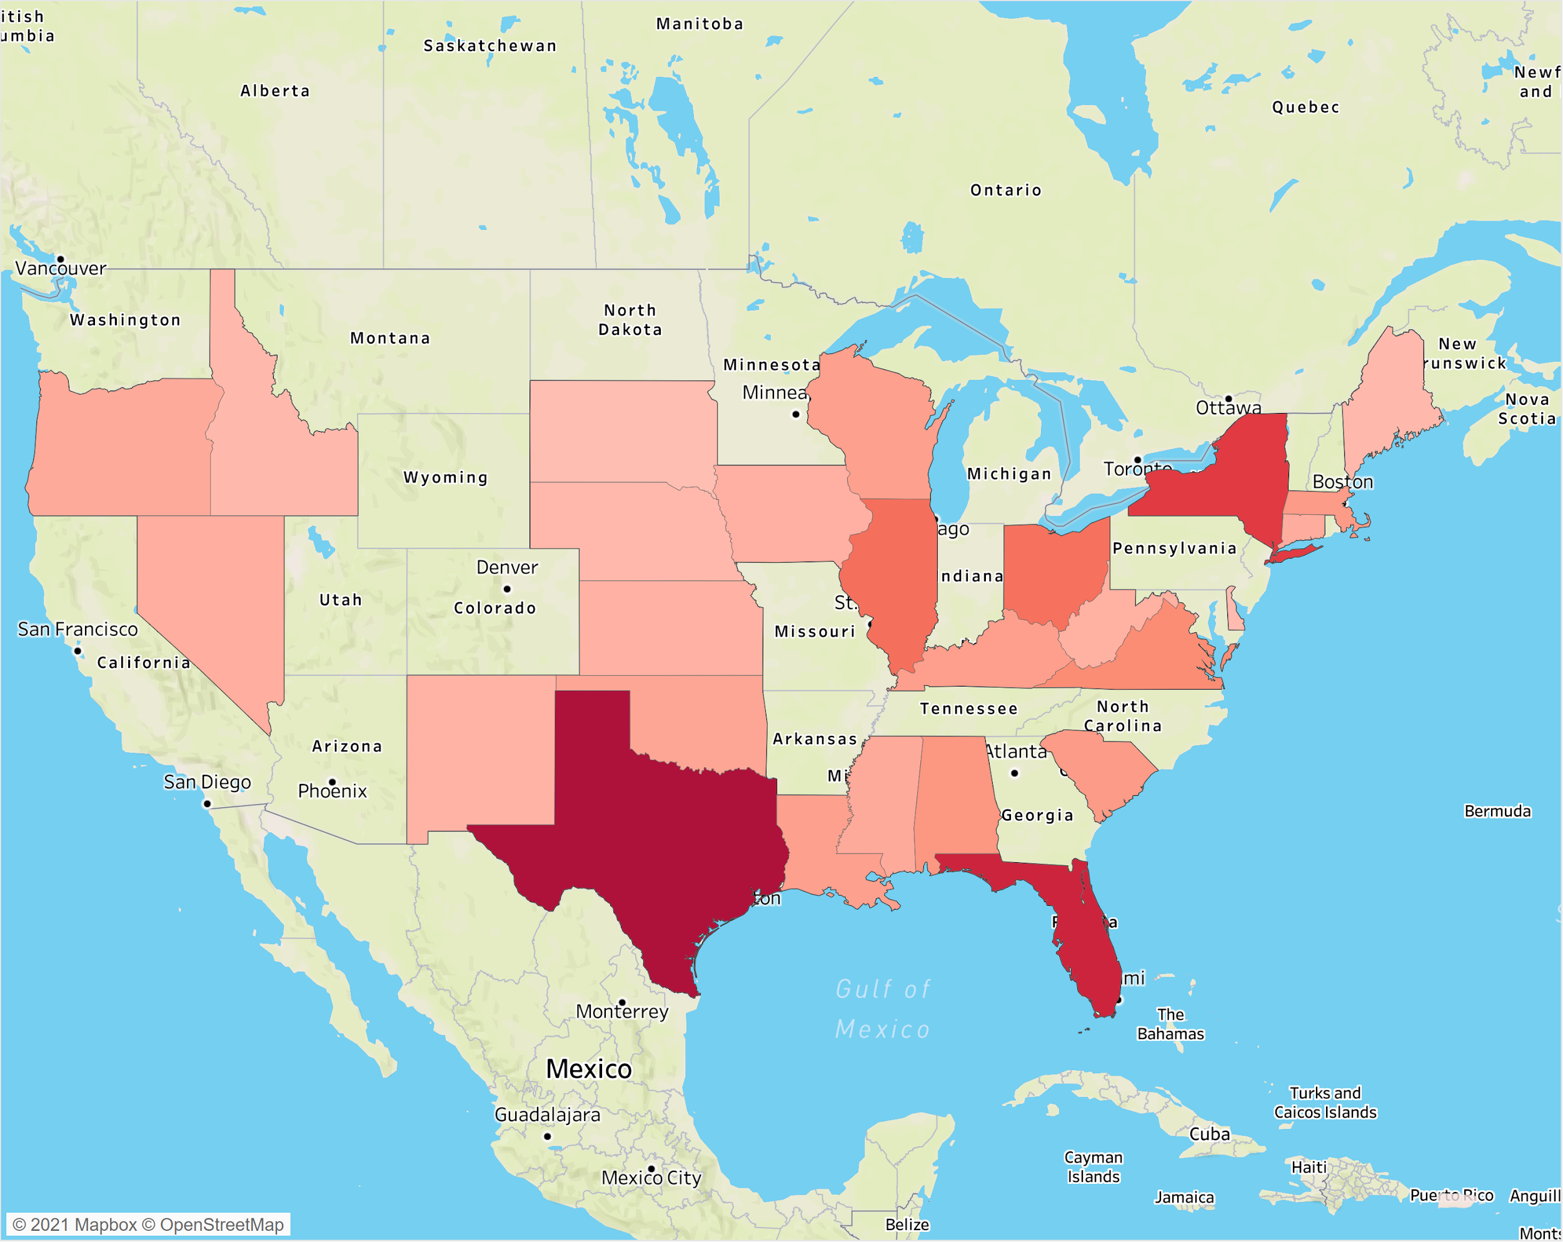
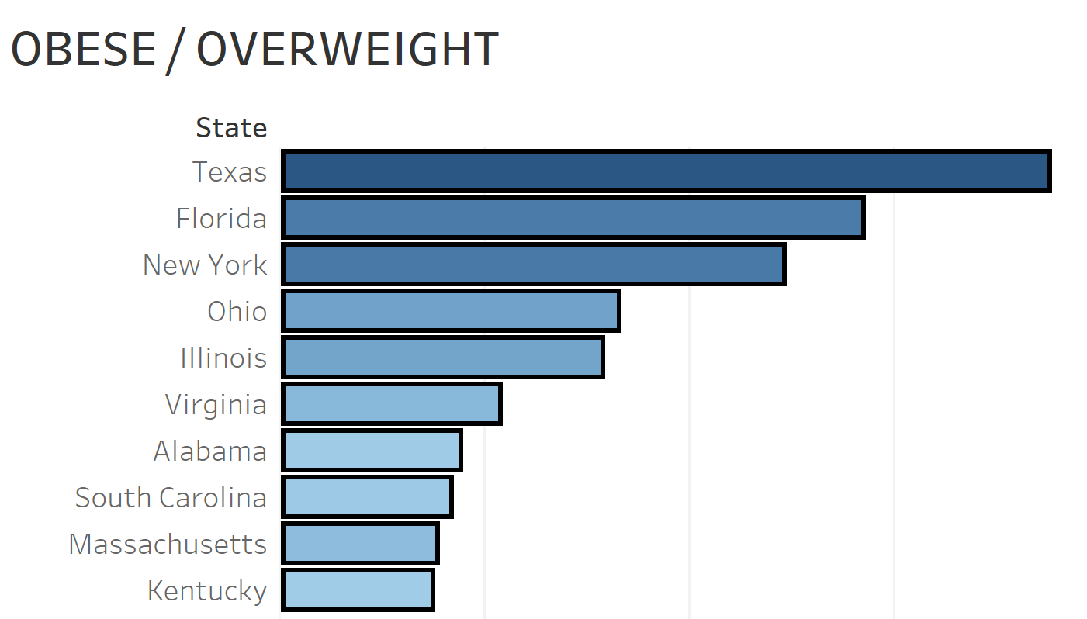
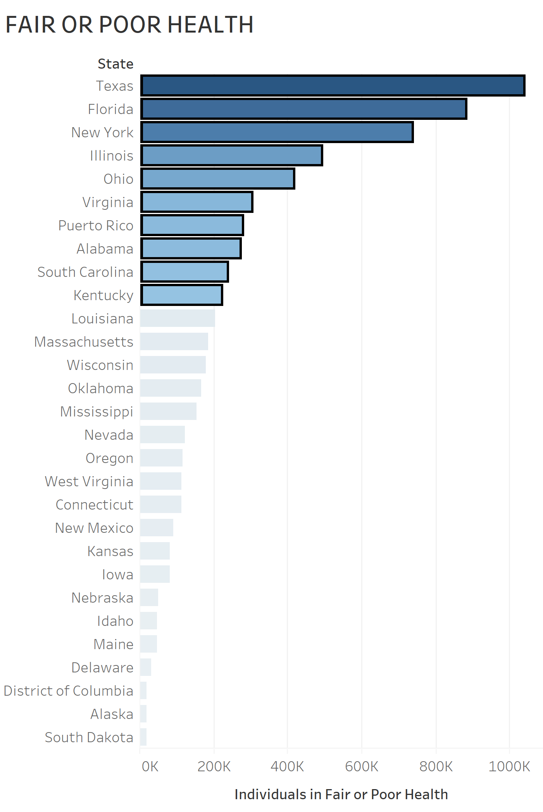
Diabetes By State

Slide 9
Results Analysis
Diabetic
Non-Diabetic
56% of diabetic test subjects were female
16%
84%
41% of non-diabetic test subjects were male
Overweight Diabetics
Overweight Non-Diabetics

Slide 10
Choosing Our Model
Random Forest Classifier with only Feature Importance
98.3%
Random Forest Classifier Full Features
97.8%
Decision Tree Classifier With Feature Importance
96.5
Support Vector Machine Model
92%
Decision Tree Classifier With Feature Importance Scaled
96%

Slide 11
Web Application
Used Post method to update user
Host backend server and render HTML
Used WTForms for user input
Flask App
Ran chosen Model on user data
Loaded user data via send method
Created a class DiabetesForm()

Slide 12
User Interface
Creating a Web Application to Determine Users Risk of Disease

Slide 13
Q&A

Slide 14
Sources Cited
https://www.idf.org/aboutdiabetes/what-is-diabetes/facts-figures.html
https://www.diabetes.org/resources/statistics/cost-diabetes
https://www.niddk.nih.gov/health-information/diabetes
https://www.vumc.org/diabetescenter/DRTC
https://www.nhlbi.nih.gov/health/educational/lose_wt/BMI/bmicalc.htm

Slide 15
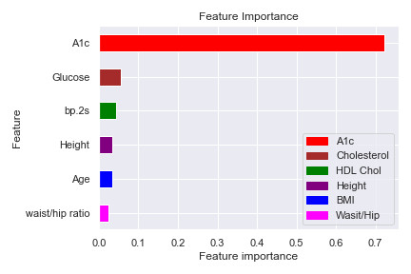
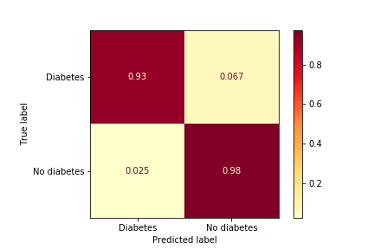
Feature importance obtained through model.feature_importances_
Confusion Matrix(read left to right, top to bottom):
TN,TP,FN.FP

Slide 16
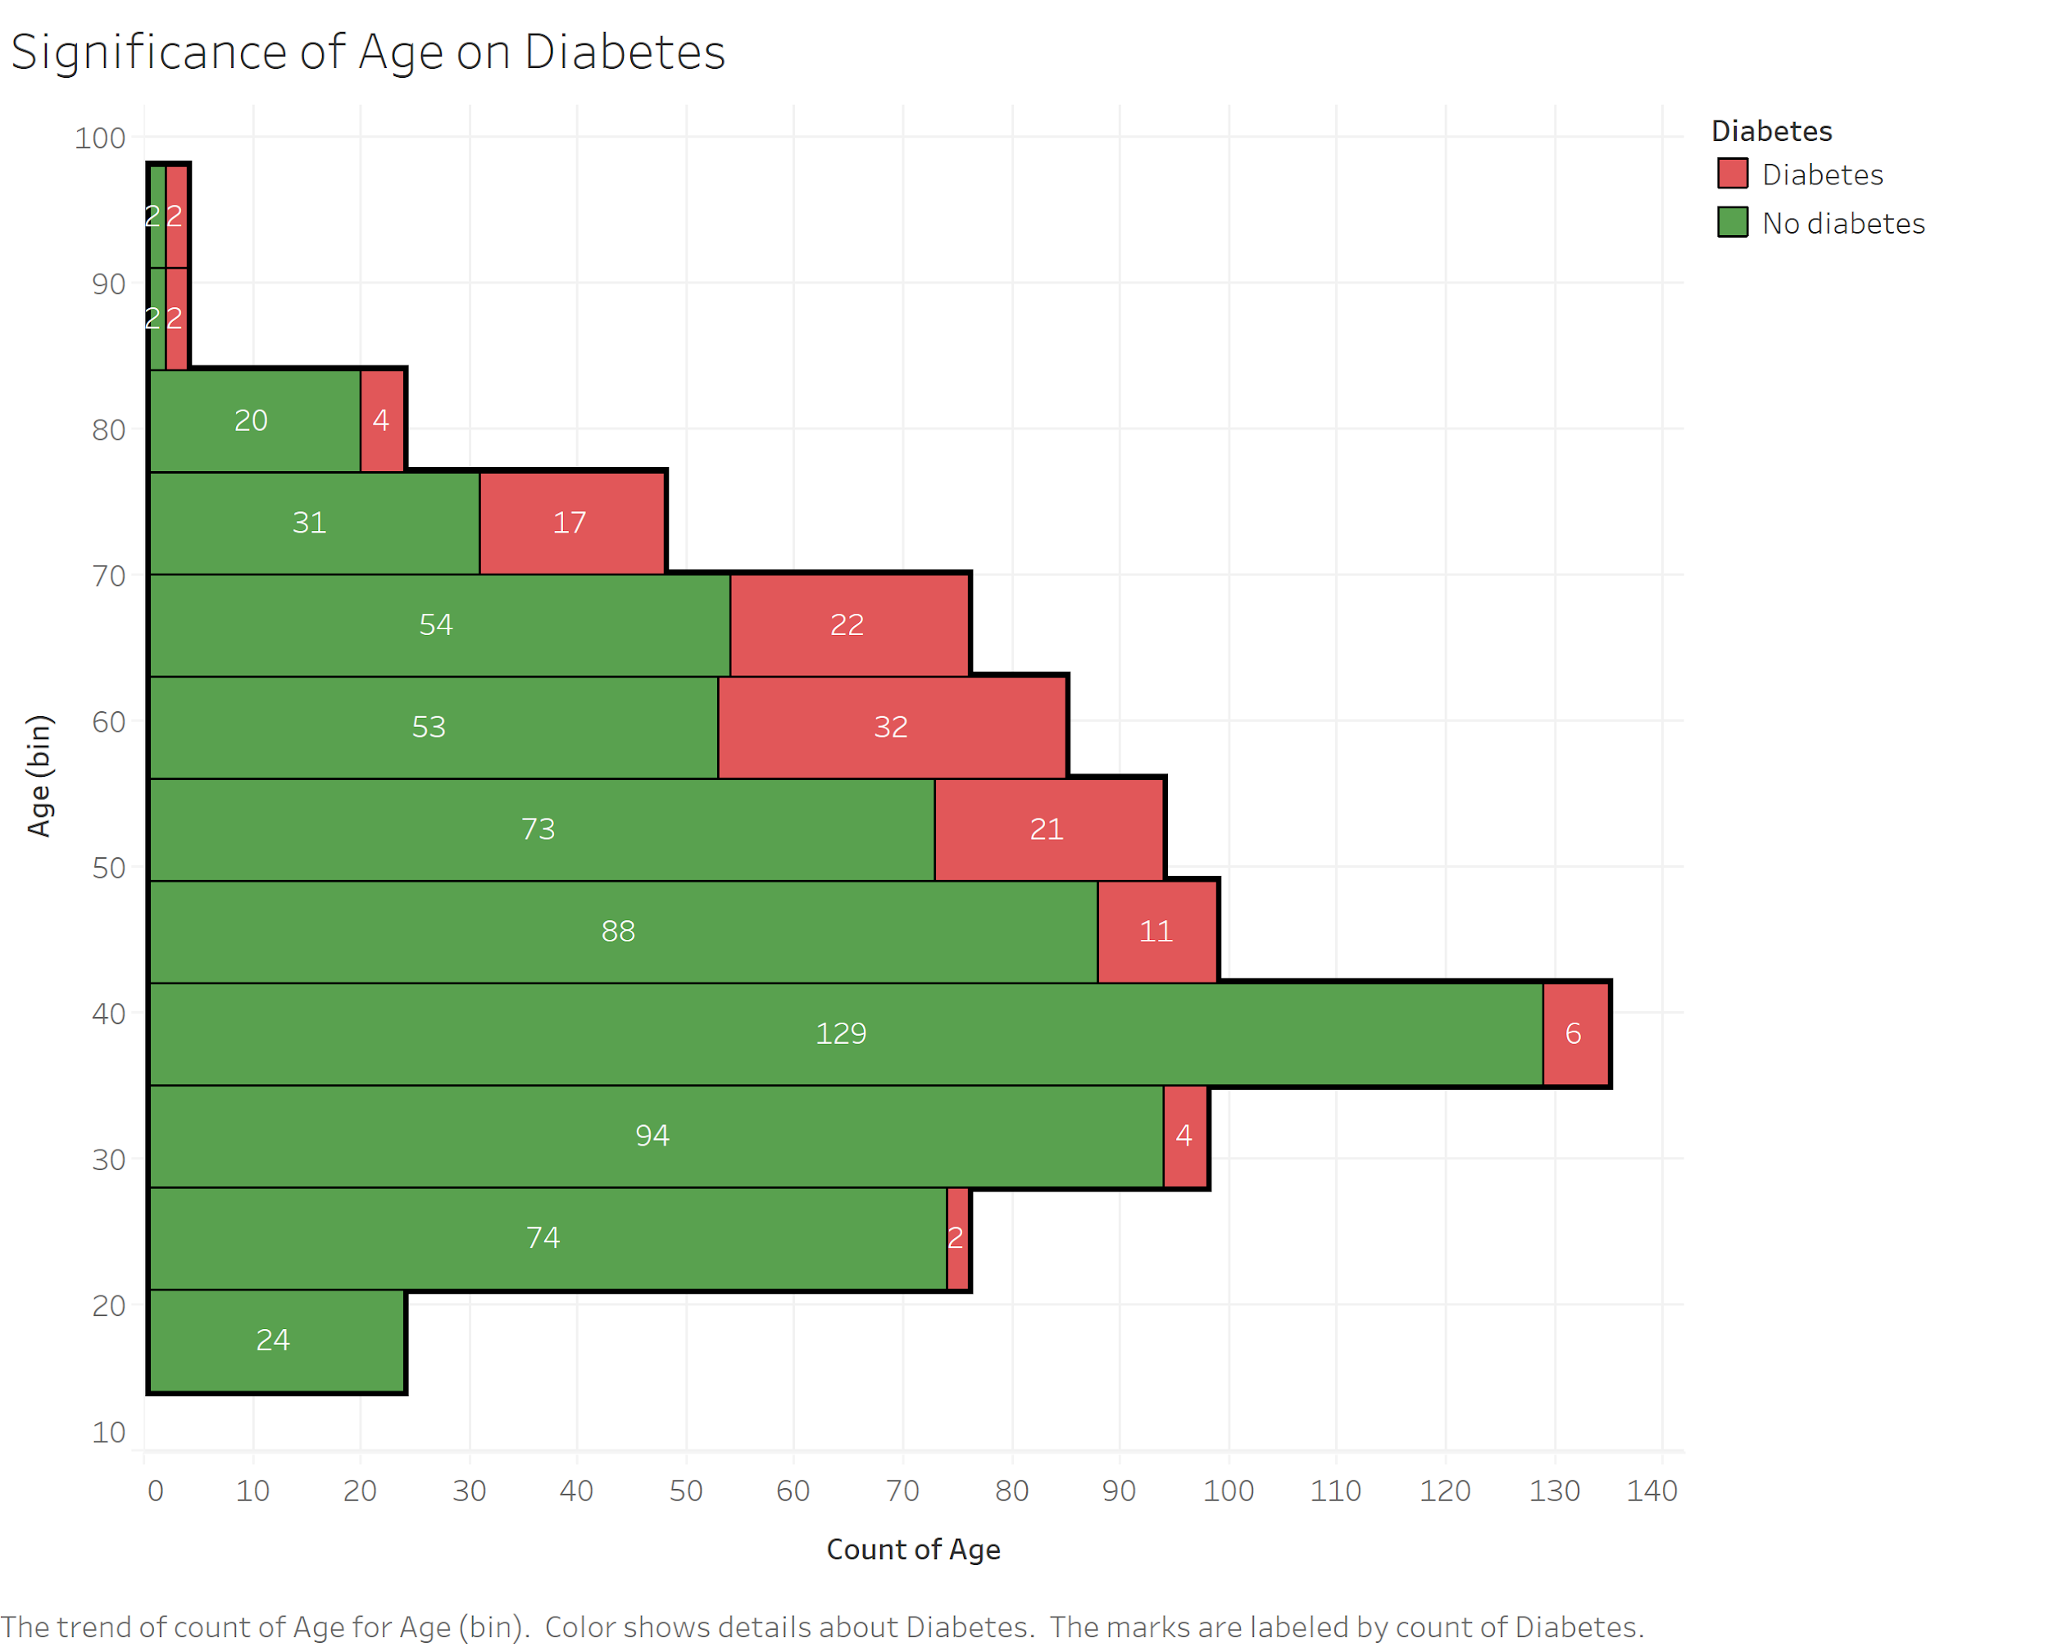

Slide 17
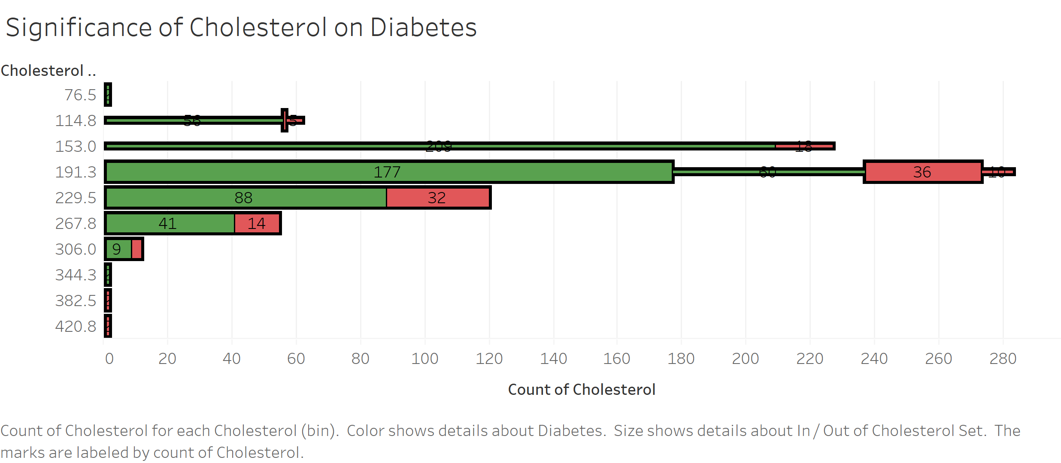

Slide 18
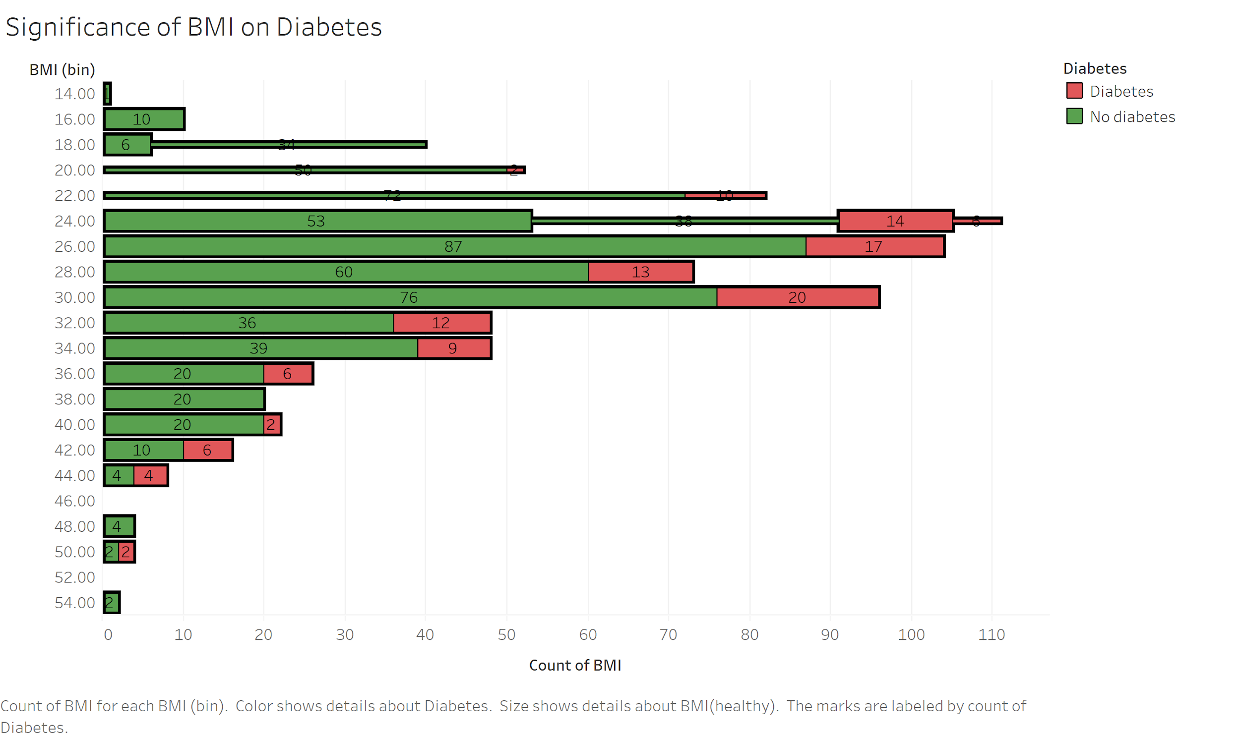

Slide 19
